Slide 1
12 Days of Christmas
Trey Bandemir

Slide 2
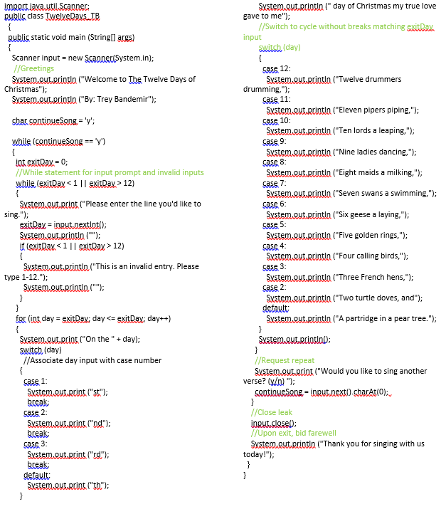
The objective
To create a code(a song) that can receive user inputs between 1 and 12 for a list (the song lines) of the song “12 Days of Christmas” and return the song lines descending from the input.
I created a similar function in Java for CS1 and wanted to replicate similar inputs and outputs.

Slide 3

The breakdown
A days_of_Christmas object was created for the days of Christmas
The variable “day” takes a user input in the range of 1-12
Once input is received, print the initial day then loops down from the input number.

Slide 4
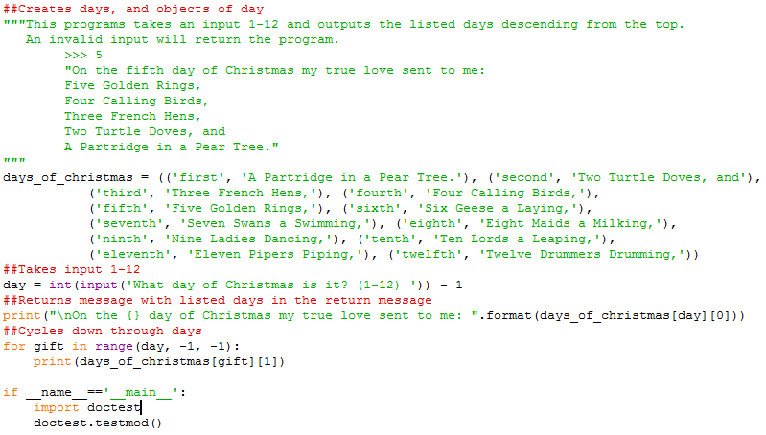
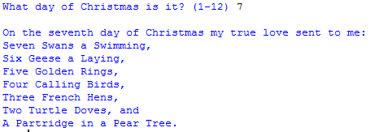
Results
Output

